Slide 1

Patient Online
EMIS National User Group
Alan McDermott
September 2015

Slide 2
Topics
Ambition for Patient Online
2014/15 Commitments and achievements
2015/16 GMS contract commitments and guidance
Clinical systems update
Status update
Ambition beyond 2016/17

Slide 3
1. Ambition for Patient Online

Slide 4
Ambition for Patient Online
Patients and Public – will be able to:
more effectively share in the responsibility for their health and welfare
have more convenient access to NHS Services
Clinicians – will be able to devote more of their time to supporting the clinical needs of patients rather than dealing with administrative and support tasks that patients can carry out for themselves
NHS – will benefit from improved health outcomes for patients, increased patient satisfaction and reduced administrative costs

Slide 5
2. 2014/15 Commitments and Achievements

Slide 6
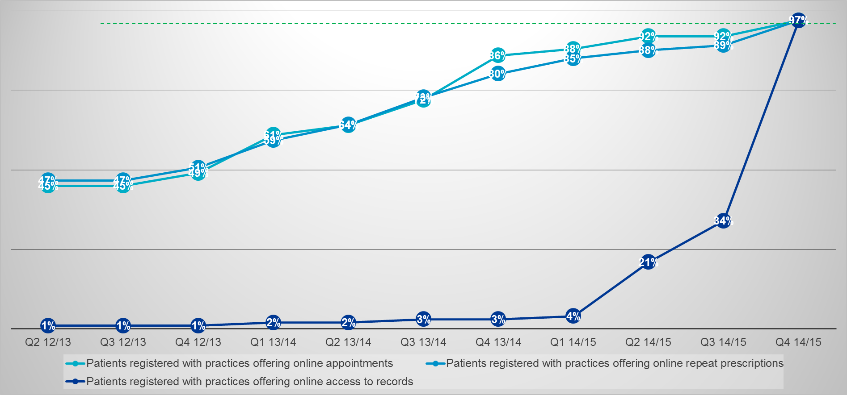
2014/15 Commitment and achievements
2014 / 15 Business Plan Commitment:
Patients are able to order repeat prescriptions online, book appointments online and have online access to the summary information in their GP records in 95% of GP practices from March 2015.
Progress towards meeting the 2014/15 Commitment:
6

Slide 7
3. 2015/16 GMS contract commitments and guidance

Slide 8
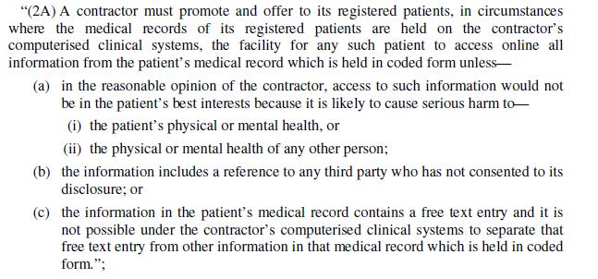
2015/16 GMS Contract commitments

Slide 9
4. Clinical Systems Update

Slide 10
Functionality for detailed coded record access – EMIS
  Detailed coded record functionality available in current release – version 5.5, available to all practices since end August 2015
  Currently being assured by HSCIC
  Future releases – enhancements to Patient Facing Services

Slide 11
5. Progress to Date

Slide 12
Appointments

Slide 13
Repeat prescriptions

Slide 14
Access to full medical record

Slide 15
6. Ambition Beyond 2016/17

Slide 16
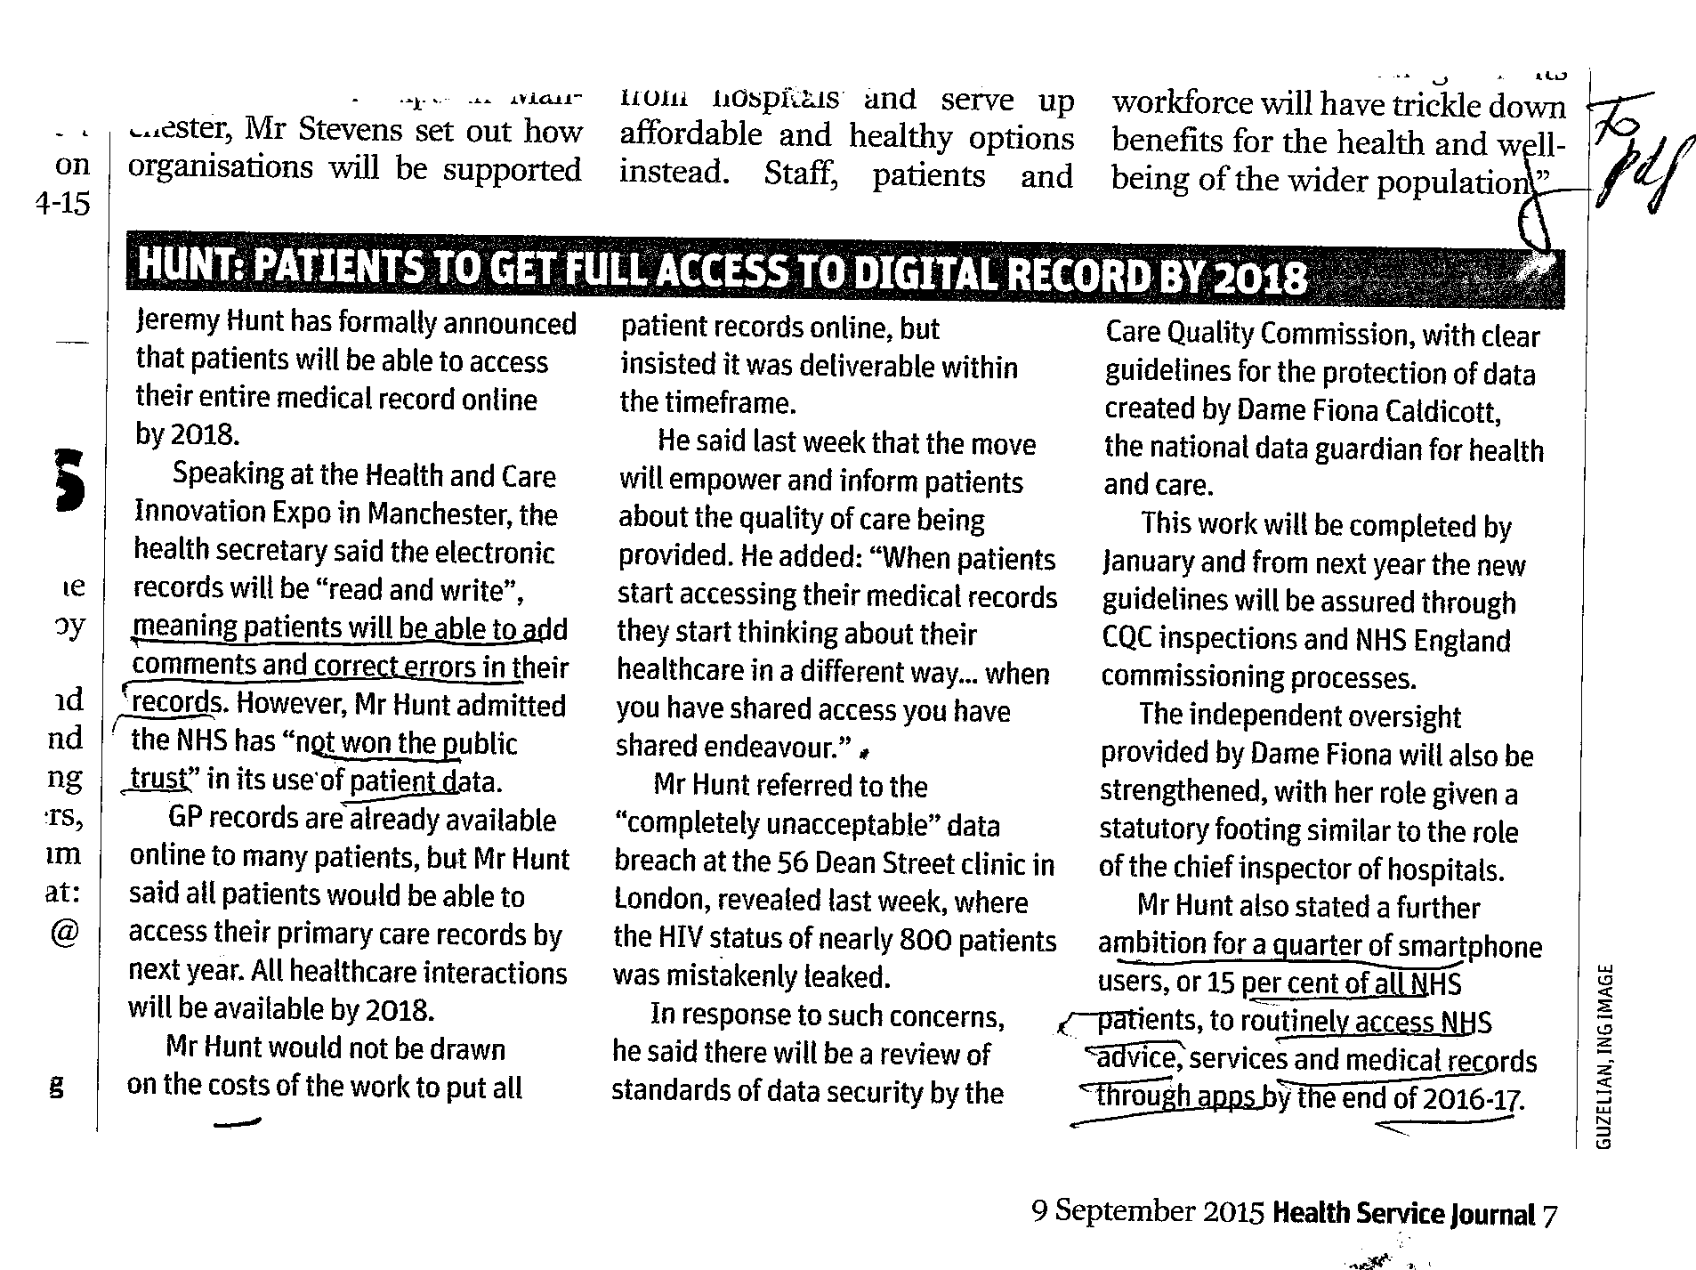
Providing patients with the ability to easily, quickly and safely access services online is a key element in modernising the NHS
2015/16
  Patients have access to the detailed coded information in their GP records
2016/17
  Greater range of apps available to patients
2018
  Patients have access to the detailed information in all their health records (primary care, secondary, community, mental)
  Patients can write into their records
  15% of patients using smartphones for access to NHS Online services
2020
  Patients have access to the information in their health and social care records
  NHS will be operating ‘paper free at the point of care’

Slide 17
How can we work together to deliver the best outcomes for patients, clinicians and the NHS?

Slide 18
Tim East
EMIS
Senior Product Manager

Slide 19




Supporting your Online Journey
Oct – Dec 2015
Jan - April 2016
April+ 2016
Best Practice to increase your online patient reg
Support Centre Resources
Online presentations
Promo pack including posters, pens, leaflets
Hints & Tips
Social Media support
GP Contract Detail Coded Record Project
Support Centre articles & videos
Online Presentations
Training
Patient Access Best Practice Project
Support Centre articles & videos
Online Presentations
EMIS Rep at User Groups
Social Medial support
ROSU, Proxy & Child Maturity Project
Notes:
Last year we ran a joint project with NHS England to support practices with enabling the SCR view in Patient Access.
This was a great project that provided you with various forms of support in enabling the SCR view.
Taking the number of sites enabled from 42% in January to 98% by April.
We are continuing to support you with your online journey this year and into 2016.
So here we have an outline of our plans:
This EMIS NUG we will be launching on next EMIS project to support practices with increasing their patient online registrations.
Our Patient Access annual survey this year was focused on gathering feedback on how you are currently promoting online services, gather best practice and ask what you wanted over and above what we are currently offering.
We received over 1100 responses and these have shaped our Patient Access Best Practice Project.
Patient Access Best Practice project
The Patient Access Best Practice Project is aimed at sharing best practice and providing resources to increase your online patient registrations.
It was clear from the responses that Patients Access saves vital admin time and is convenient for the patient.
So the project is launched today and if you want a “Best Practice” pack come to the EMIS Patient Access stand.
We have also updated information and a video on the support centre, along with hints & tips and further supporting information.
GP Contract Detail Coded Record Project
We will be starting the support project to assist you with enabling and implementing the detail coded record as part of this years GP Contract.
We see this running in a similar manner to the project last year with the SCR.
With a joint project from EMIS and NHS England to support you in a smooth switch on and implementation at your practice.
ROSU, Proxy & Child Maturity Project
Our development teams are currently working on this functionality and there is going to be quite a lot of functionality to digest and start using in your practice along these themes.
So we will be running another supporting project from April next year, to ensure you understand this functionality and how to use it.
Further information will be available later this year.
The Patient Access Product Owner, Tracy is here at the conference and is happy to discuss this with you at the Patient Access Stand.
Tomorrow we have an EMIS presentation at 9:40am and will be running through the Best Practice guidance and showing you the wireframes for the ROSU & Proxy access functionality, so please come along.

Slide 20
Johan Taylor
“A Practice Manager experience”
Marple Cottage Surgery, Stockport CCG

Slide 21
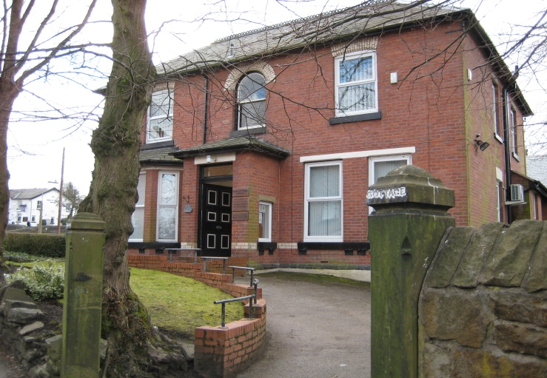

Patient Access – a practice perspective
Johan Taylor
Managing Partner
Marple Cottage Surgery,
Stockport, Cheshire

Slide 22
My practice
Offering online appointments since 2000 (pre-EMIS)
Offering patient direct email to GP since 2001
Adopted EMIS patient access system in 2005
Offering full access to medical record since 2006
Developed online consultation system with EMIS in 2007
(winner of Health Informatics Accolade Award 2007)
Testing video consultation with EMIS in 2015

Slide 23
Benefits of online appointments and repeat prescriptions
Patient choice
Reduced footfall
Reduced telephone demand
Reduced DNA
More efficient prescription process

Slide 24
Online medical record access
“Patients have the right to see their medical records, though
in practice much communication between professionals is
not available to the patient concerned. Patients often do
not know why they are being referred, or what is being
Said about them”
NHS Plan, 2000

Slide 25
Online medical record access
“By providing access to the medical record in either paper or
electronic versions, we may improve patients‘ understanding
about their role in their condition, and we may improve the patient-physician relationship.” Fowles J. (2004)
3 common reasons for patients wanting access to medical record:
to be more involved in their health care (74%)
to understand their condition better (72%)
to have a nosey at what doctor had said about them! (74%)
Fowles J.B. et al, Patients' Interest in Reading Their Medical Record, Arch Intern Med. 2004;164:793-800.

Slide 26
Benefits of online access to medical records
Patient right to view records (DPA)
Empowerment
Transparency
Time saving – ask patient to find information for themselves
Improved quality / governance
Curiosity leads to self-care

Slide 27
Current barriers to realising benefits of online medical record access
Resistance
  Top down approach / lack of engagement
  Practice culture
  Individual beliefs and assumptions
Fear
  perceived workload
  mistakes
  of what is written
2015-16 Contract: “there is no contractual requirement to provide online access to any free text that may be included within the patient record.”
  Coded data is not enough
  Free text and document access helps patient to reflect post-consultation and to encourage culture of self care

Slide 28
Unintended consequences / management issues
National rollout = increased process bureaucracy
Demand = new practice workload
Practice policy decisions:
  Potential for bad news seen by patient before GP
  ‘Abnormal’ results from pathlabs
  Parental access to child records
  consultations from previous practice received GP2GP?
Serious governance issue
  3rd party information / sensitive data

Slide 29
Restricting access to health records
The data controller may limit or deny access to a health record where:
  • the information released may cause serious harm to the physical or mental health or condition of the patient, or other person, or
  • access would disclose information relating to or provided by a third person who has not consented to that disclosure
  The Data Protection (Subject Access Modification) (Health) Order 2000

Slide 30
Data controller obligations
Practice is the Data Controller
Practice must comply with Data Protection Act
Practice must have safe policy & procedures in place, with comprehensive training for staff (competency)
Practice can restrict access if feel harm to patients; sensitive data can be excluded
Third party information must be excluded as required by data protection act and common law duty of practice

Slide 31

How? Who? When?
How do you manage access in your practice?
Who is reviewing each new request to check if may cause harm to patient to have access to records?
Who is reviewing existing patient access
status to assess if access should be withdrawn?
When do you have time???

Slide 32
3rd party / sensitive data
How do you ensure that records are vetted and 3rd party data is not shared?
Changes required to support practice to encourage document access
  Author responsibilities
  Tag / mark documents
  Clinical system automated system to remove from patient viewer

Slide 33
Online patient access is the future, but how far in the future depends on you
Thank you for listening
Johan Taylor, johantaylor@nhs.net

Slide 34
Marilyn Gollom and Dominic Sexton
“A patient experience”

Slide 35


Records Access
Patient Experiences
Marilyn Gollom & Dominic Sexton
From the Patient Participation Group at
Thornley House Medical Centre
Hyde, Tameside, Greater Manchester

Slide 36
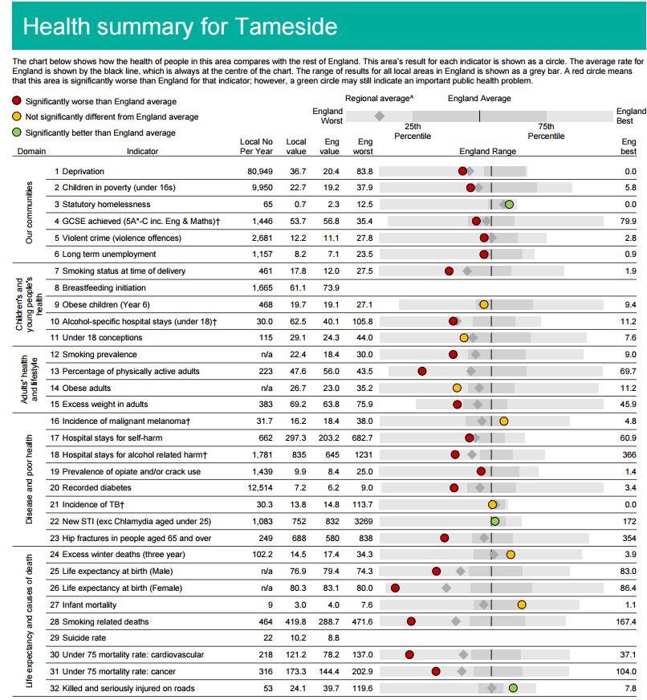
Tameside’s Health Profile
Public Health England's profile for Tameside shows that the area performs very poorly by many measures

Slide 37

Hyde
Deprivation
Poor health
Lack of engagement
Low activity
High obesity
How can we improve health in the
community?

Slide 38

Patient Initiatives
Take health to the public
Encourage self care
Health Pledge

Slide 39
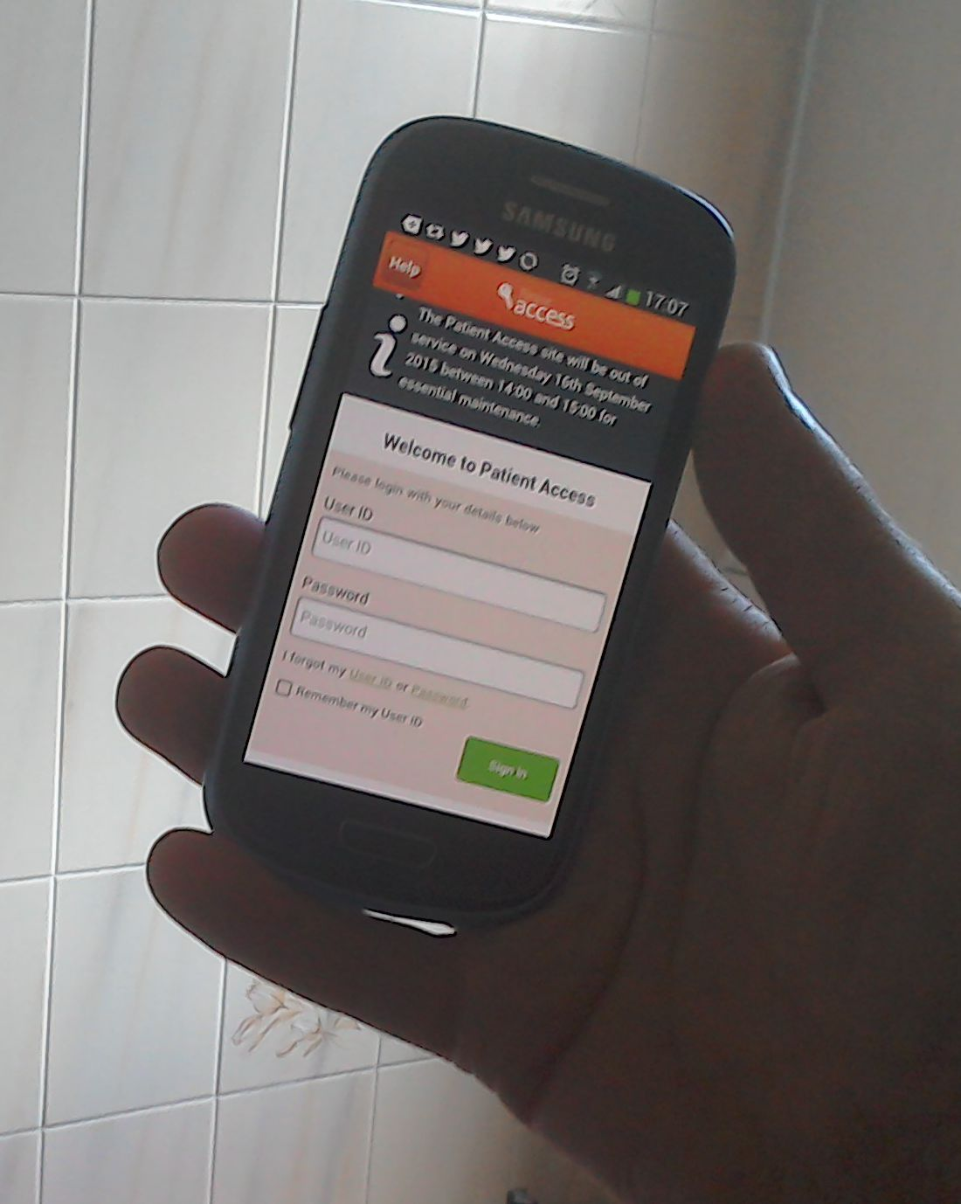
Technology
76% of UK adults now have smart phones
Apps allow quick access to information & data
Yet to make big inroads into healthcare

Slide 40
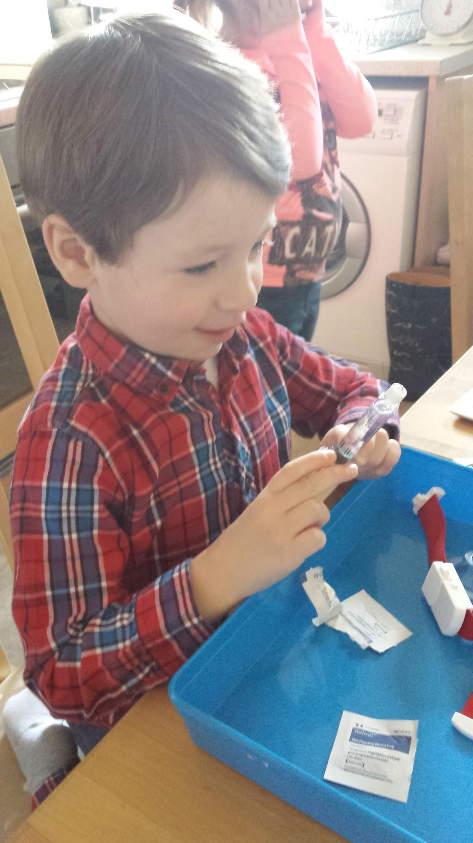
Marilyn's reasons for being here
Living without the NHS
Culture of dependency
Self care & Records Access
Harry
A minute to reflect

Slide 41
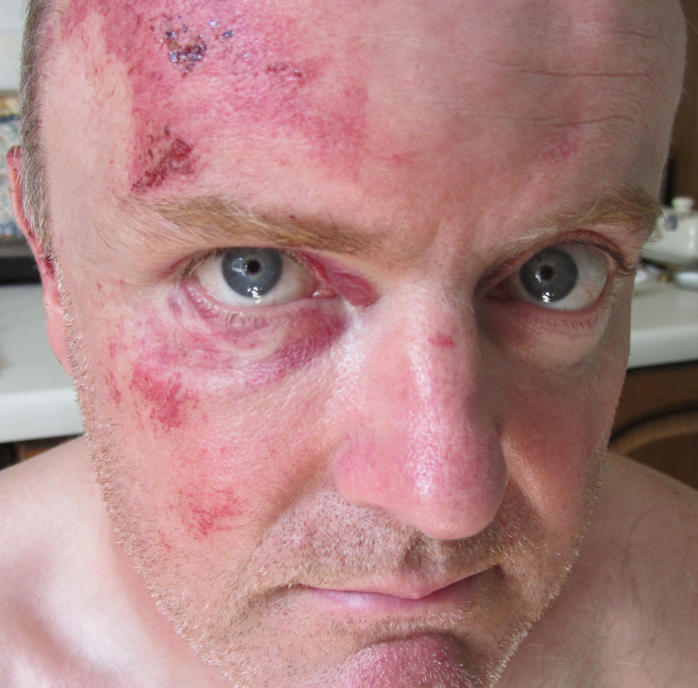
Dominic's Bump
Cycling RTA
Unconscious then groggy at A&E
Memory loss – few recollections of hospital care

Slide 42

Patient campaign to help people get healthier
Small steps easy to start and keep going
Over time small changes add up
Encourages responsibility for own health

Slide 43

Records Access & Health Pledge
pieces in the healthcare puzzle

Slide 44
Patient Online
Programme
Detailed
Coded
Record
Access
Dr Masood Nazir
National Clinical Lead
Dr Damian Williams
Digital Clinical Champion
September 2015

Slide 45
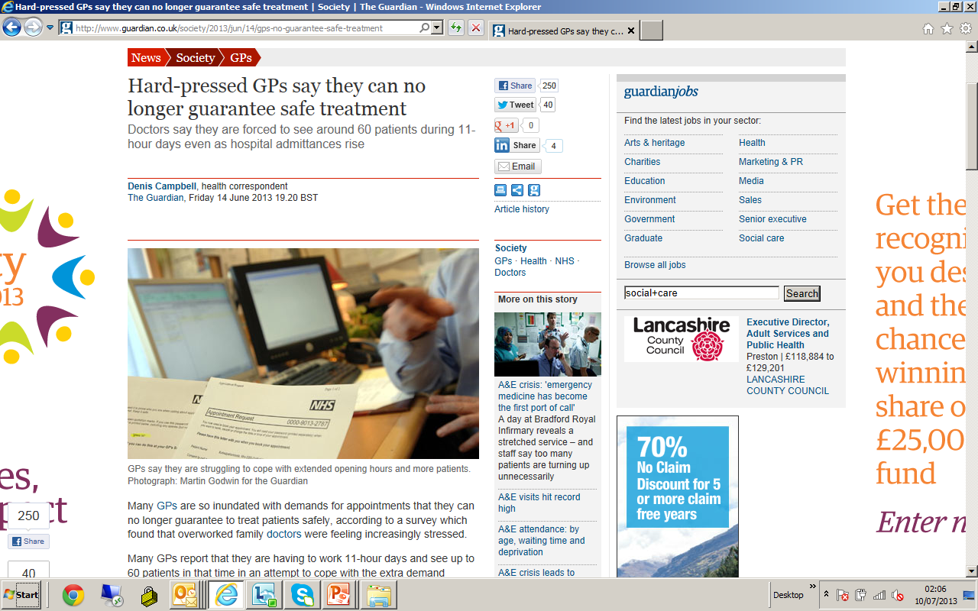
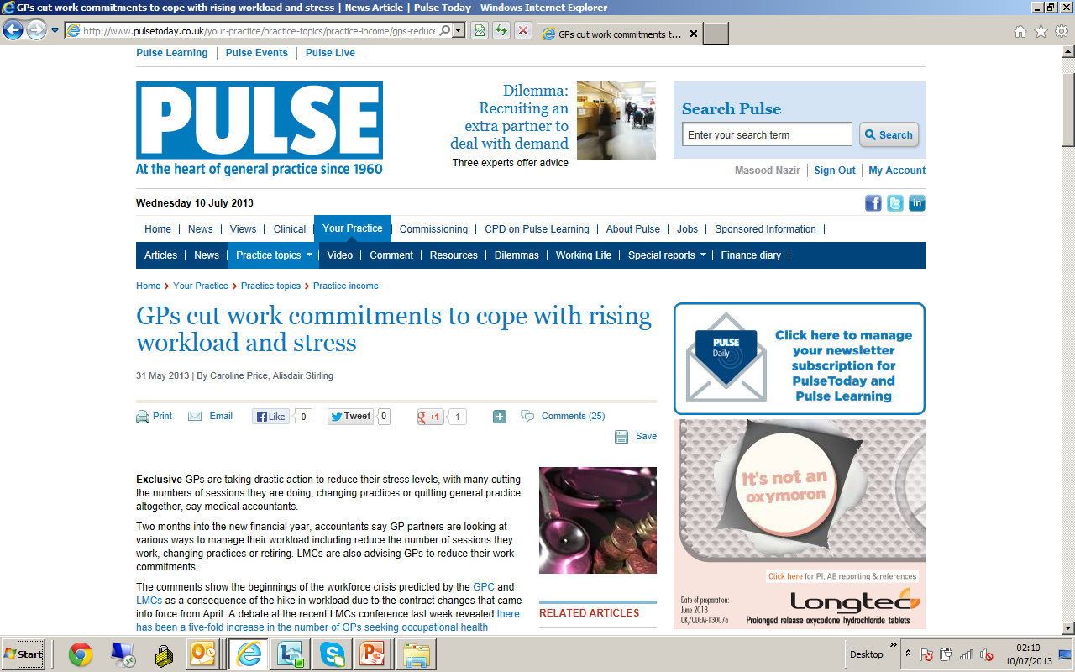
Hitting the headlines

Slide 46
The challenges
Over last 10 years:
the demand on the NHS has increased significantly
increased ageing population
increase in GP consultations from 260,000,000 to 360,000,000 per year
consultations becoming more complex due to factors such as multiple LTCs.
General practice only receives about 7.7% of the NHS budget.

Slide 47
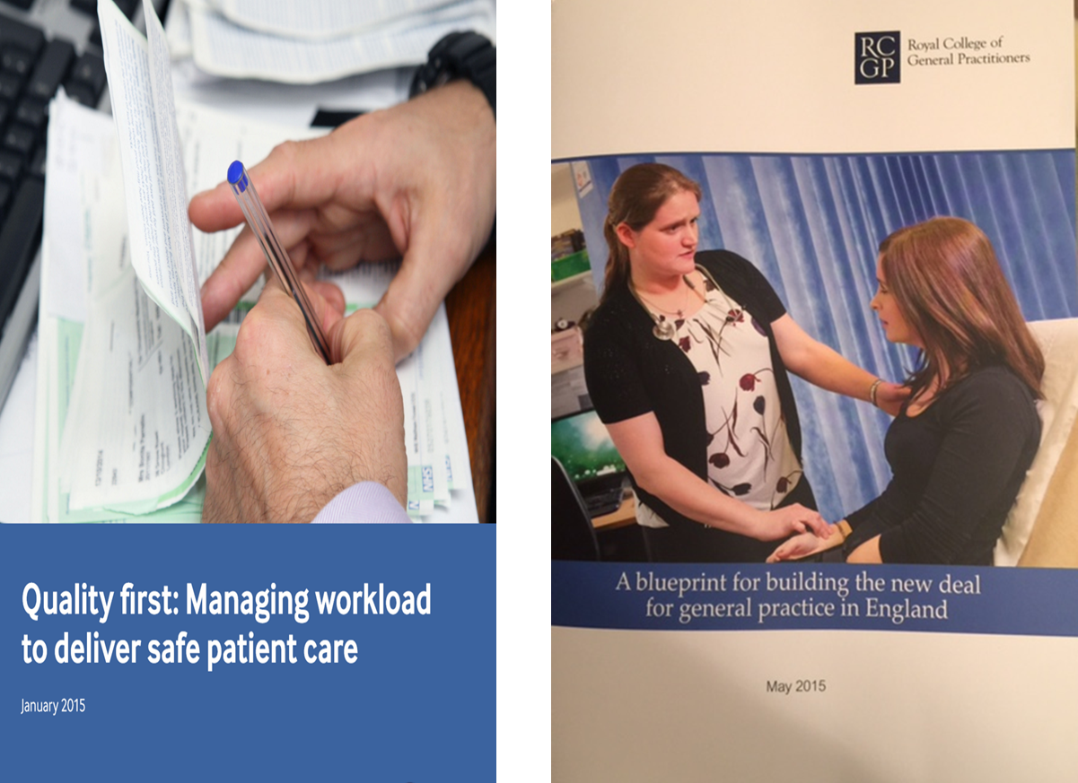


BMA and RCGP

Slide 48
Saving time for GP practices
Every appointment booked and each prescription ordered is one less to deal with manually
18.5%
Of activity takes place at the weekend
On a typical weekday 47.1% of activity is either before 08:00 or after 18:00
47.1%

Slide 49






All coded data
For clarity – all this coded data will be from the day electronic records started i.e. no ‘date from’ option
Demographics
Other codes (ethnicity, QOF)
Allergies / Adverse reactions
Codes showing referral made or letters received (no attachments)
Medication (dose, quantity and last issued date)
Coded data
Procedure Codes (medical or surgical) and codes in consultation (signs, symptoms)
Immunisations
Problems / Diagnoses
Results (numerical values and normal range)
Values (BP, PERF)
49
Notes:
For Example
Diagnosis codes – Asthma, Suspected UTI, Viral illness (in readcodes this is mainly the codes starting with a letter eg H33)
Codes about signs and symptoms – anything patient reports or doctor finds – cough, vomiting, abdominal tenderness, normal heart sounds
Procedure codes – operations, injections, ear syringing, dressings etc – anything we do to the patient
Administrative codes – everything else! – ethnicity, occupation, recalls, QOF codes, exemption codes, referrals (8H…), letter to patient, etc etc
Practice Level Configuration
All coded data
Patient Level Configuration
Control to enable this option set on by default
Desirable Requirements
Control to enable this option to be evaluated in each system ? Enabled on case by case basis

Slide 50
Overriding Principle
The coded record must be MEANINGFUL to the patient

Slide 51




Advice for Practices
To note:
You do not need to share coded information if they feel harm to patients
Assessment of access should be offered on a case by case basis
Acknowledging workload for practices
Safe & legal policies & procedures
You can
Exclude free text
Set date from when you
start sharing free text
& documents
(reducing workload to screen notes)
Exclude letters
Notes:
Acknowledging workload for practices
Safe & legal policies & procedures
You do not need to share coded information if they feel harm to patients
Access should be offered on a case by case basis
You can
Exclude free text
Exclude letters
Set date from when you start sharing free text & documents ( reducing workload to screen notes)

Slide 52
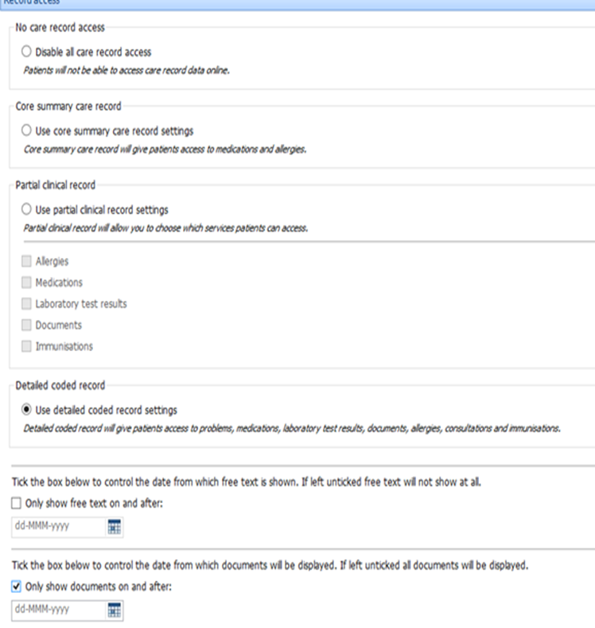
EMIS 5.5

Slide 53
1.
Detailed Coded record settings
Problems
Medications
Allergies
Lab test results
Immunisations
Consultations with coded information
Documents will display unless you action as per box 3 below
EMIS 5.5 to meet GMS/PMS contractual obligation
2.
Leave unticked
and no free text will show
3.
Tick Box and Set date for
1st April 2016.
This will stop any documents being displayed at present

Slide 54
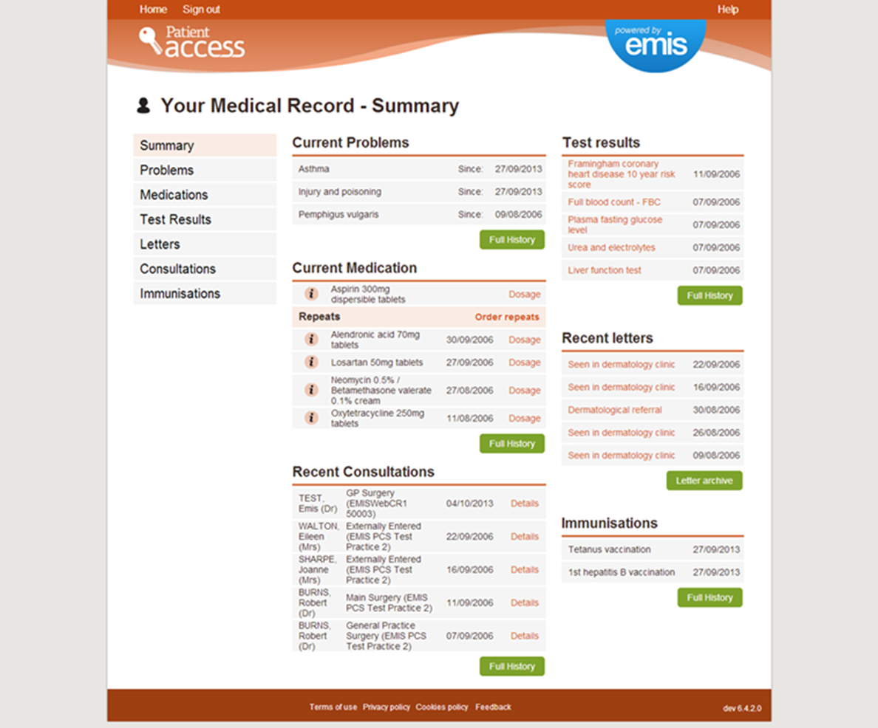
EMIS Record Sharing Configuration and Patient View Screens

Slide 55
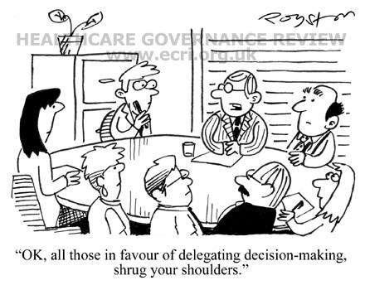
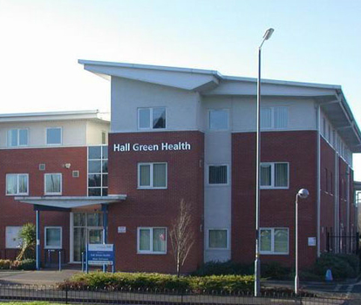
Decision Making/Practice Policy and processes

Slide 56



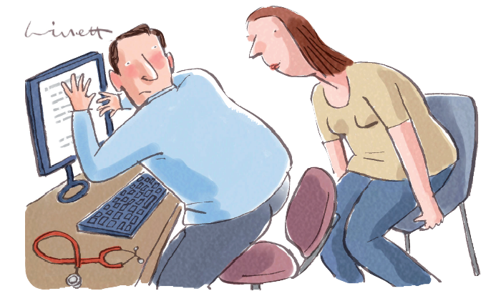
Shared information is a relationship of trust
Patients and information are the two most under-used resources in the NHS
Dr. Richard Fitton
Cartoon with thanks to the British Medical Journal

Slide 57
ICO advice
Practice must comply with data protection act
All staff who process/enable access must have had training in policy & procedures ( awareness of risks)
If there was a complaint - ICO would want to check that practice had safe policy & procedures in place
Practice should communicate at what stage they are at in process of offering access (this should not detract from completing subject access request where this is appropriate)

Slide 58






What we are doing to support you
System functionality
explanation
Detailed setup guide
Guidelines for practice
and checklist
Declining access to records
guidance
See one, do one, teach one
Sensitive codes
guidance
Letters / attachments
guidance (inc. DocMan)
Details on how to screen notes before access
Tools / protocols / templates for automation

Slide 59
Patient Online
Programme
Detailed
Coded
Record
Access
Dr Damian Williams
Digital Clinical Champion
September 2015

Slide 60
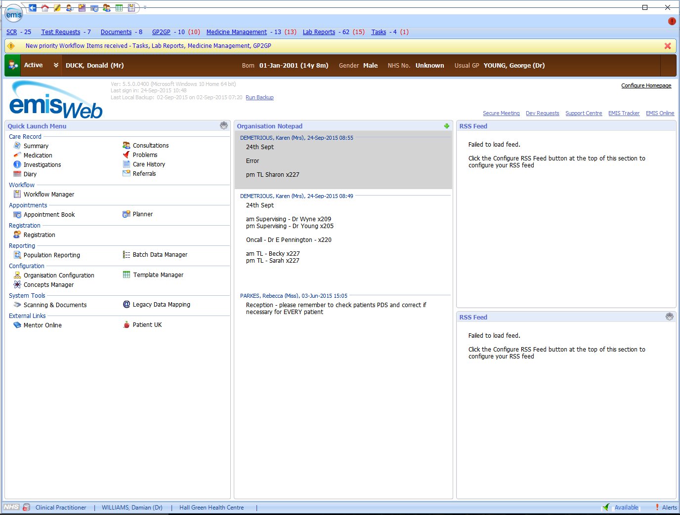
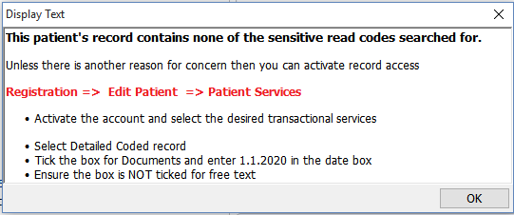
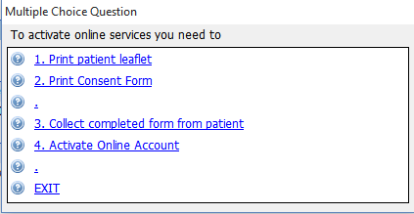
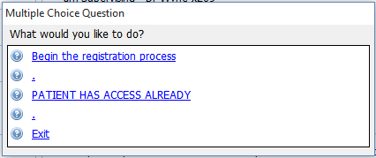


Slide 61
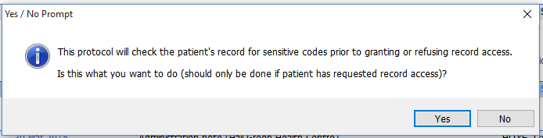
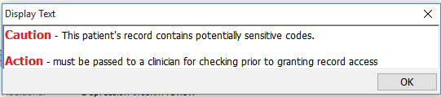

Slide 62
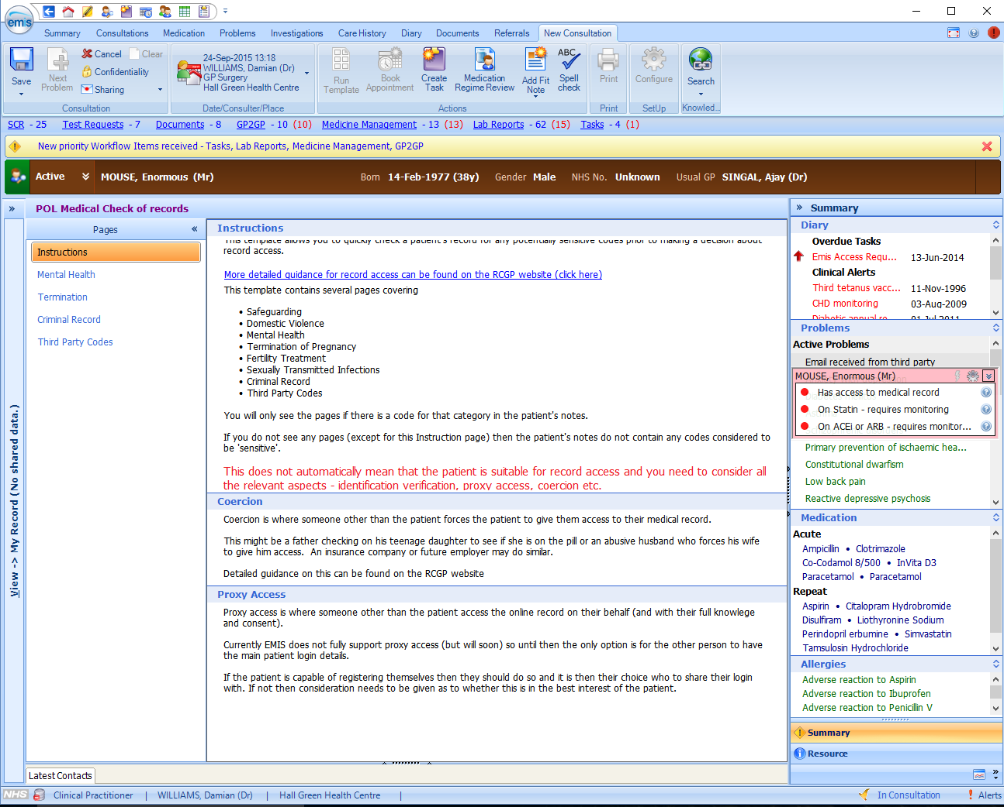

Slide 63
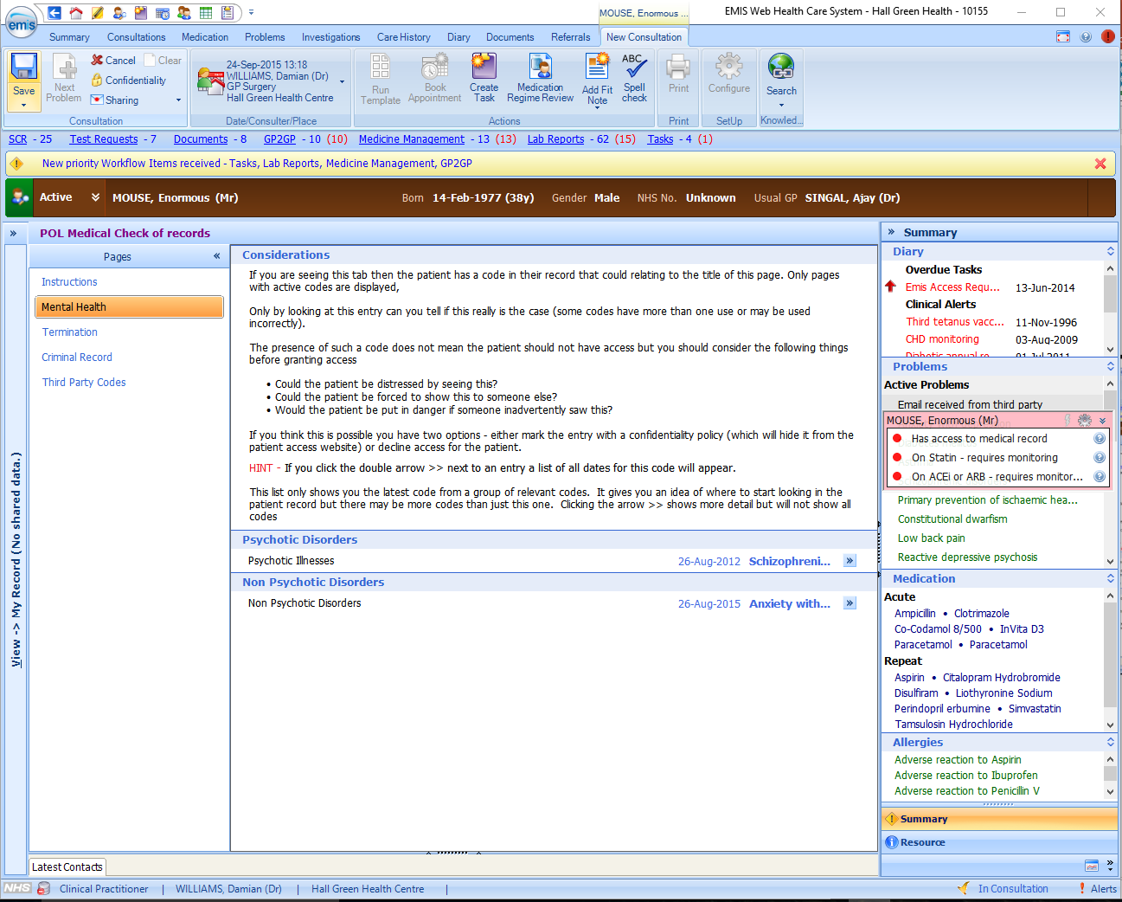

Slide 64

Next steps 2015/16 – practices
System & GPSoC functionality
Benefits & evidence
National implementation
Guidance & support
Track progress
Notes:
What are we likely to need to do in 2015/16 to secure delivery of commitments to online access to detailed coded information (Practices)?
Develop guidance/a support programme for practices in how to meet their commitments under the GMS contract
Carry out research/evidence gathering and presentation that will persuade practices of the benefits and value of offering this service
Establish ways of working with the system suppliers and clarify what GPSoC functionality will deliver
Assign implementation resources to work with practices across the UK
Develop a definition of success with associated monitoring system to track progress throughout the year

Slide 65

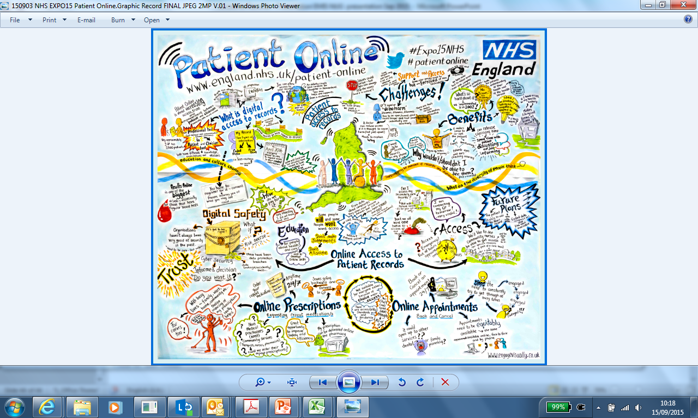

Thank you!

Slide 66
EMIS National User Group
September 2015

Slide 67
Online access to medical records: yes, but….
Gene Feder
EMISnug conference
September 24th 2015

Slide 68
online access to general practice records
Government flagship policy and strong support from patient groups and GP enthusiasts:
  “Patients’ access to their electronic record: offer patients access as soon as you can”
  Brian Fisher BJGP 2013
access to summaries now
goal for all patients to have access to full record by 2020

Slide 69
Why?
health information in the record belongs to the patient who has at least equal rights of access as healthcare providers
benefits to patients in terms of experience satisfaction, feeling able to take control of their own health care
possible increased patient safety when patients have online access to medication lists.

Slide 70
But
we do not know whether online access translates into better health or health care for patients or whether it improves service efficiency.*
Mold F BJGP 2015
*not one study of potential harm from breaches of privacy or confidentiality

Slide 71
cardinal principle of health care
First do no harm

Slide 72
potential harm in relation to safety and confidentiality
arises from coercion:
patients unwillingly giving others access to their online medical record
resulting from overt threats or physical force in an abusive relationship
appearing under the guise of helping
a vulnerable relative

Slide 73
potential consequences
References to abuse or maltreatment in
the medical record seen by household
members may lead to:
escalation of the abuse
restricted access to health care for victims
pressure or aggression directed at the practice to change the record.

Slide 74
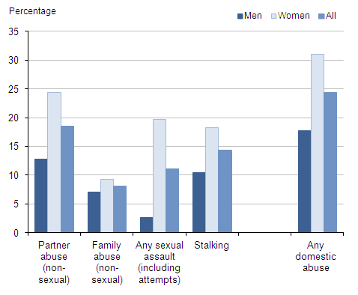
Lifetime prevalence Crime Survey England and Wales 11/12
may be higher in clinical populations
31
24
18
13
9
7

Slide 75

past-year prevalence of partner violence in different health care settings

Slide 76
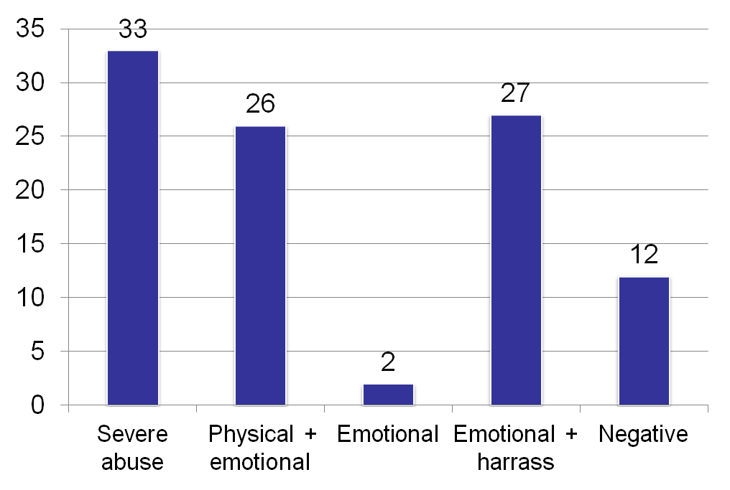
type and extent of abuse in general practice populations (Hegarty et al, 2009)

Slide 77
health impact (WHO 2005)

Slide 78
mental health consequences
(Howard 2013, Golding 1999)
 | OR (95% CI)
depression | 2.8 (2.0 to 3.9)
PTSD | 7.3 (4.5 to 12.0)
alcohol abuse | 5.6 (3 to 9)
suicidal thoughts | 3.6 (2.7 to 4.6)

Slide 79
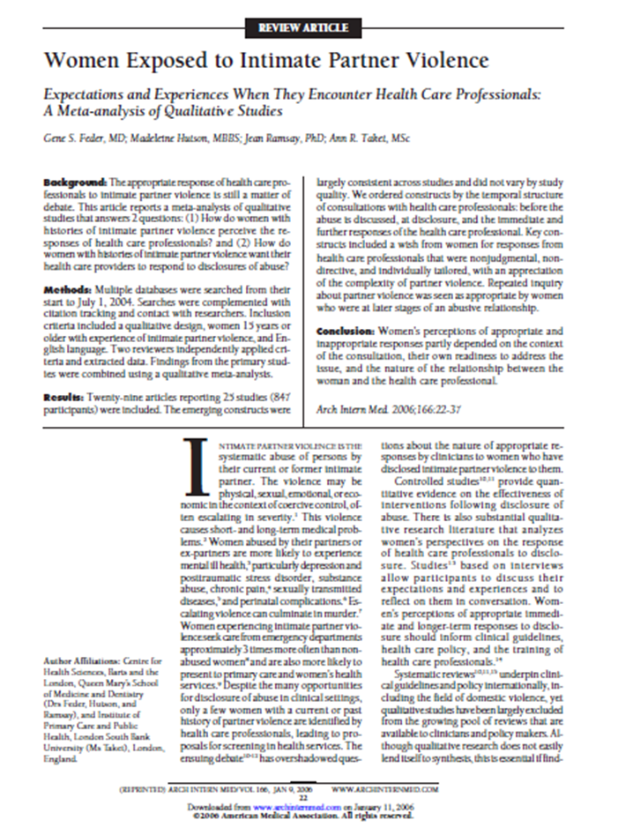
What do DVA survivors want from GPs?
To be asked about current and past
abuse and for the disclosure to be kept confidential,

Slide 81
potential harms beyond DVA
coercion of teenagers to allow parental access
GP inhibition about recording early suspicions of abuse
unwanted revelation of:
  current confidential information given by a 3rd party
  past history of abuse unknown to the patient
  past history to a carer who has legitimate access

Slide 82
mitigating risk of harm?
RCGP recommends
that patients are:
informed about the dangers of sharing login details when they register for online
signposted to abuse support services,
&
that practices are:
informed about coercion
remain vigilant for it
withdraw online access if coercion is suspected/know

Slide 83
EL2 - Coercion

Slide 84
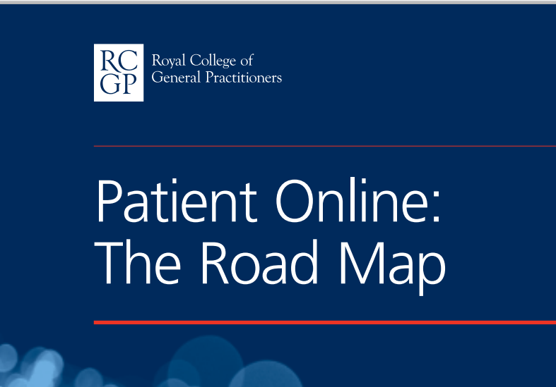
Please note that the layout will differ on the build slightly to ensure text is not crowded.
Identifying and Dealing with Coercion
Patient Online: The Road Map (2013) adds the following guidance on coercion:
Click on the numbers below to learn about each of these.
1
2
3
4
5
6
7
Notes:
Resources – link to The Road Map - http://elearning.rcgp.org.uk/pluginfile.php/74129/mod_page/content/10/Patient%20Online%20-%20the%20Road%20Map.pdf

Slide 85
Please note that the layout will differ on the build slightly to ensure text is not crowded.
Identifying and Dealing with Coercion
Patient Online: The Road Map (2013) adds the following guidance on coercion:
Click on the numbers below to learn about each of these.
1
2
3
4
5
6
7
Ask every patient if someone else might access their record without the patient’s consent and against their wishes if they are offered online access. If so, do not grant access, and remove access if it has already been granted

Slide 86
Please note that the layout will differ on the build slightly to ensure text is not crowded.
Identifying and Dealing with Coercion
Patient Online: The Road Map (2013) adds the following guidance on coercion:
Click on the numbers below to learn about each of these.
1
2
3
4
5
6
7
Ask every patient if someone else might access their record without the patient’s consent and against their wishes if they are offered online access. If so, do not grant access, and remove access if it has already been granted
Consider the potential for an abusive partner or family member to gain access via coercion or deception, thereby increasing their control over the patient’s health

Slide 87
Please note that the layout will differ on the build slightly to ensure text is not crowded.
Identifying and Dealing with Coercion
Patient Online: The Road Map (2013) adds the following guidance on coercion:
Click on the numbers below to learn about each of these.
1
2
3
4
5
6
7
Ask every patient if someone else might access their record without the patient’s consent and against their wishes if they are offered online access. If so, do not grant access, and remove access if it has already been granted
Consider the potential for an abusive partner or family member to gain access via coercion or deception, thereby increasing their control over the patient’s health
Practices may wish to hide sensitive codes, for example those relating to domestic violence or any codes or consultation information a patient may request, so that they cannot be viewed online. It is recommended that practices refer to their system suppliers for more information (see Resources). System suppliers may also have the ability to share consultation information from a certain date going forward, called prospective sharing. As a practice you may wish to use this feature when planning how you offer record access to patients.

Slide 88
Please note that the layout will differ on the build slightly to ensure text is not crowded.
Identifying and Dealing with Coercion
Patient Online: The Road Map (2013) adds the following guidance on coercion:
Click on the numbers below to learn about each of these.
1
2
3
4
5
6
7
Ask every patient if someone else might access their record without the patient’s consent and against their wishes if they are offered online access. If so, do not grant access, and remove access if it has already been granted
Consider the potential for an abusive partner or family member to gain access via coercion or deception, thereby increasing their control over the patient’s health
Practices may wish to hide sensitive codes, for example those relating to domestic violence or any codes or consultation information a patient may request, so that they cannot be viewed online. It is recommended that practices refer to their system suppliers for more information (see Resources). Your GP system supplier may also have the ability to share consultation information from a certain date going forward, called prospective sharing. As a practice you may wish to use this feature when planning how you offer record access to patients.
Domestic violence (DV) training highlights the need for communication between the practice and a domestic violence agency. Communication from DV agencies and multi-agency risk assessment conferences (MARACs) to general practice will lead to sensitive letters in the medical record. Some practices may choose it is best for such vulnerable patients not to have online record access at all. Other practices may have processes where they actively hide sensitive information whilst still offering online services. Practices will vary in their processes and services they feel able and comfortable to manage.

Slide 89
Please note that the layout will differ on the build slightly to ensure text is not crowded.
Identifying and Dealing with Coercion
Patient Online: The Road Map (2013) adds the following guidance on coercion:
Click on the numbers below to learn about each of these.
1
2
3
4
5
6
7
Ask every patient if someone else might access their record without the patient’s consent and against their wishes if they are offered online access. If so, do not grant access, and remove access if it has already been granted
Consider the potential for an abusive partner or family member to gain access via coercion or deception, thereby increasing their control over the patient’s health
Practices may wish to hide sensitive codes, for example those relating to domestic violence or any codes or consultation information a patient may request, so that they cannot be viewed online. It is recommended that practices refer to their system suppliers for more information (see Resources). System suppliers may also have the ability to share consultation information from a certain date going forward, called prospective sharing. As a practice you may wish to use this feature when planning how you offer record access to patients.
Domestic violence (DV) training highlights the need for communication between the practice and a domestic violence agency. Communication from DV agencies and multi-agency risk assessment conferences (MARACs) to general practice will lead to sensitive letters in the medical record. Some practices may choose it is best for such vulnerable patients not to have online record access at all. Other practices may have processes where they actively hide sensitive information whilst still offering online services. Practices will vary in their processes and services they feel able and comfortable to manage
If a patient discloses abuse from a partner or adult family member, this should never form part of an online accessible record. Practice staff must reassure any patients with Patient Online access who choose to disclose abuse to their GP, that this will never be visible away from the practice

Slide 90
pitfalls of the guidance
underestimates complexity and hidden nature of coercion
“walled gardens” not available yet but online access is…
Potential loss of complete and cumulative medical record if GPs do not recordsensitive information

Slide 91
conclusion
pilot sites should share their efforts to address the potential harms of online access
Limit access to recent information
which has clear medical utility:
  test results
  referral letters
  clinic letters
  current medication
  and allergies.
let’s be careful out there

Slide 92
references
Thanks to Jenny Woodman, Ruth Gilbert and Alex Sohal

